Slide 1

Data
Cleaning
Todd Abraham
Iowa State University

Slide 2

Why Clean?
Data Quality
Assessing Usability
Standardization
End Use
Linkage – Connecting and Comparing
Analysis – Conclusion Validity
Decision Making – With Accurate Information

Slide 3
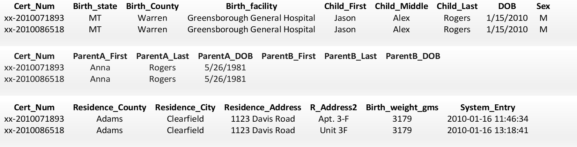
“Final Data” are already Clean!
[Human] Errors Happen
Data Entry Errors
Workflow Errors

Slide 4
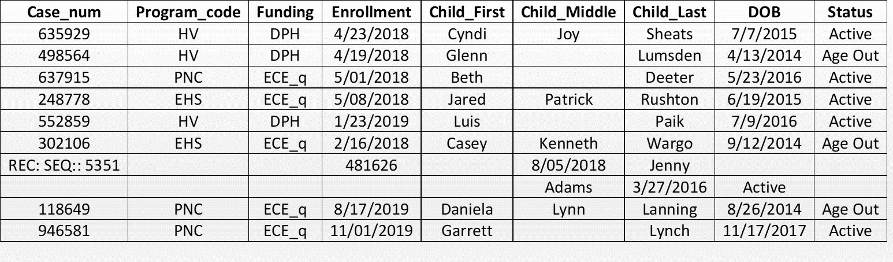
“Final Data” are already Clean!
[Computer] Errors Happen – Because Humans Cause Them

Slide 5
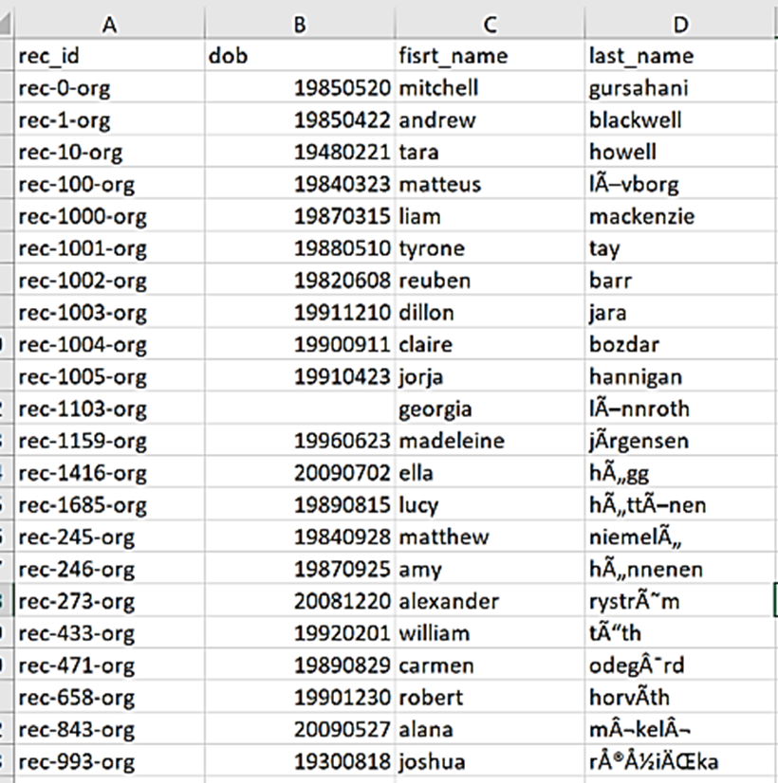
Data Cleaning Step #1
LOOK AT THE DATA!
Start Documenting

Slide 6
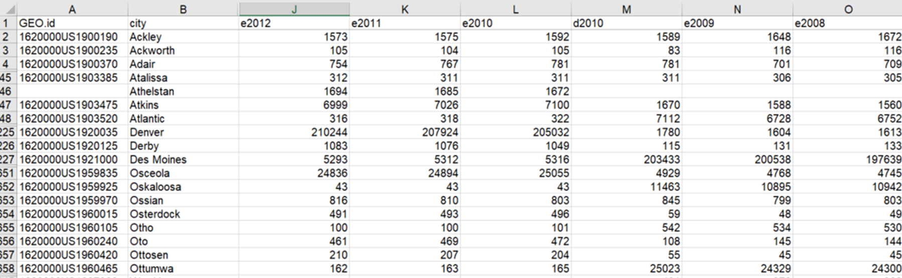
Data Cleaning Step #2
LOOK AGAIN (Closely)
Keep Documenting!

Slide 7
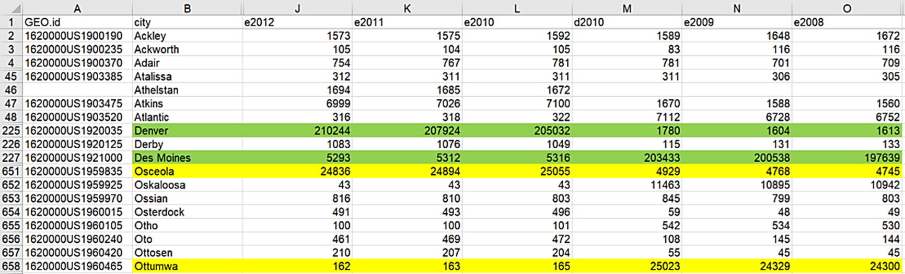
Investigate
Spot Check
Confirm (if possible)
Keep Documenting!
7

Slide 8
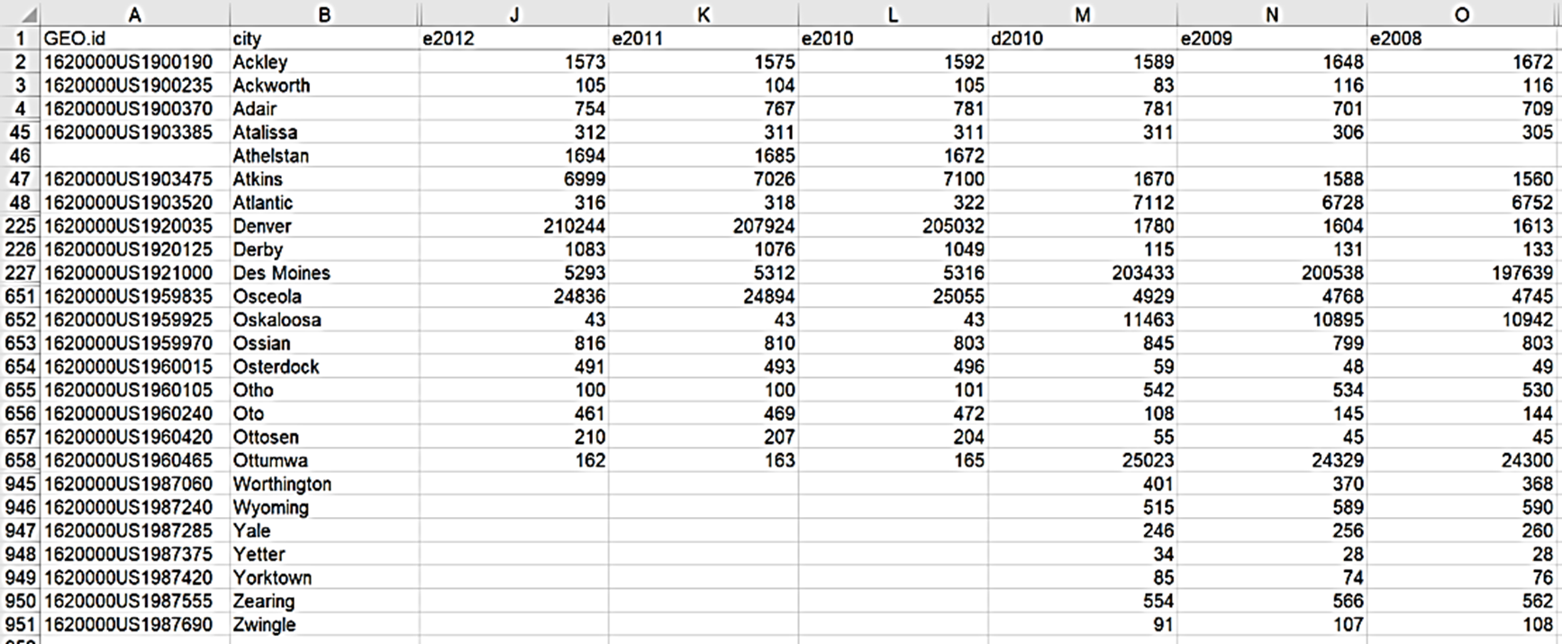
Decision Time
Fixable?
Usable?
Worth It?
8

Slide 9
If Fixable
Apply Correction
Repair vs. Remove
Order of Operations
Split II, III, Jr, Sr from names: John III → John I
Verify (optional?!)
Did Correction Work?
Did it Break Something Else?
John IV → John but what happened to Olia (Olivia)
Document Everything!
9

Slide 10
Cleaning Categories
Standardization
Different Codes across Systems (gender)
Changing Codes
Different Codes within Systems over Time (race 4 = 7)
Changing Collection
New/Deleted Questions over Time (missing ≠ missing)
10

Slide 11
Cleaning Numeric Values
Out-of-Range
Values (outliers) – impossible values?
Distributions (no variance) – when there should be?
Missing Values
Skip Patterns
N/A (not NA)
DK vs. REF
Fill it In?
11

Slide 12
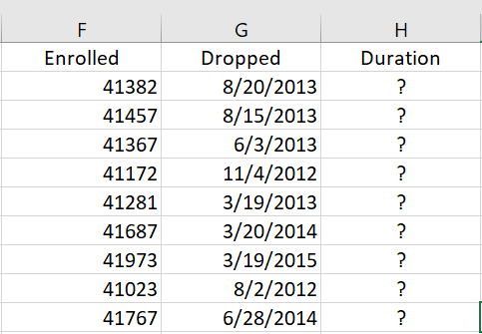
Cleaning Dates
Formats
Standardize: [mm] [dd] [yyyy] or yyyy-mm-dd
Origin Dates:
01/01/1960 10/14/1582
12/30/1899 01/01/1904
Invalid Entries
Month – Distribution?
Day – Distribution? How many months have 28 days?
Year – Distribution? Cohorts?
12

Slide 13
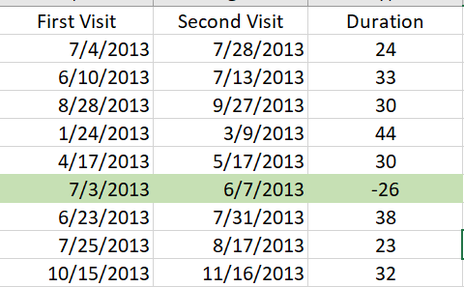
Cleaning Dates (cont.)
“Multivariate Distributions”
Most Common Date(s)?
Least Common Date(s)?
Impossible Date(s)?
Suspicious Date(s)?
Difference in Dates?
13

Slide 14
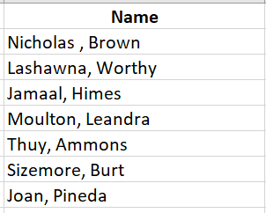
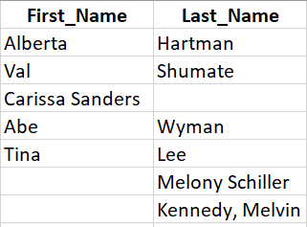
Cleaning Names (Text Strings)
Standardize
UPPER/lower – You Choose, be Consistent
Fields – 1 or 2 (or 3 or 4?)
Consistent Fields
First, Last and Last, First in Same Field!
[First][Last], [First Last], [Last First]
In Same Two Fields!!!
14

Slide 15
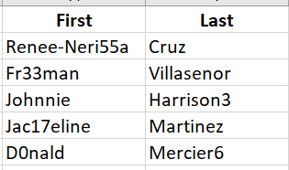
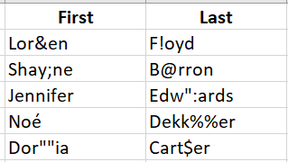
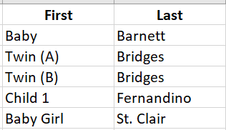
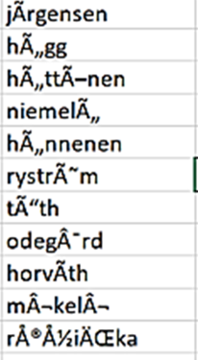
Cleaning Names (cont.)
The Unusual Stuff
Numbers (suffixes?)
Punctuation
Place Holders
These Things
15

